Slide 1

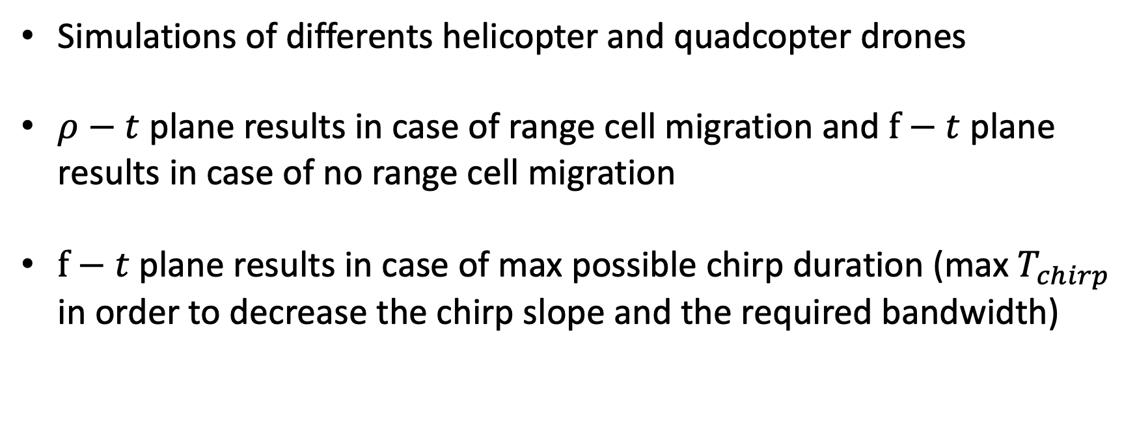
Contents
Simulations of differents helicopter and quadcopter drones
$ρ−t$ plane results in case of range cell migration and $f−t$ plane results in case of no range cell migration
$f−t$ plane results in case of max possible chirp duration (max $T_{chirp}$ in order to decrease the chirp slope and the required bandwidth)

Slide 2
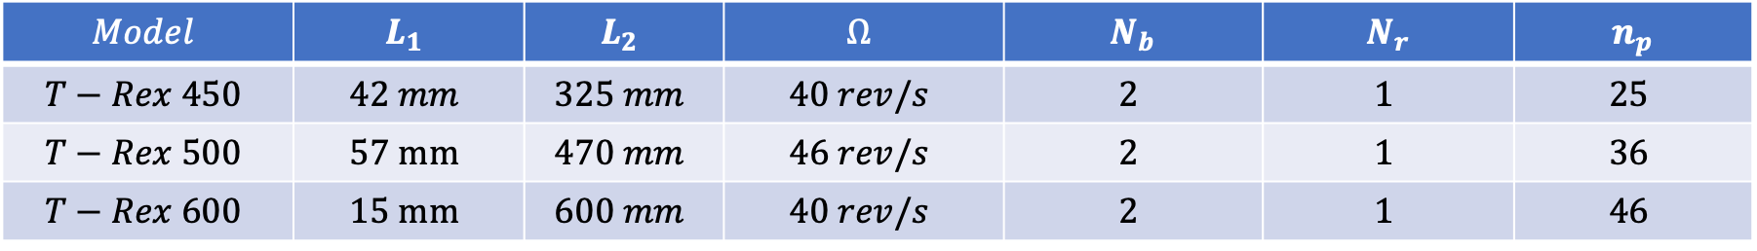
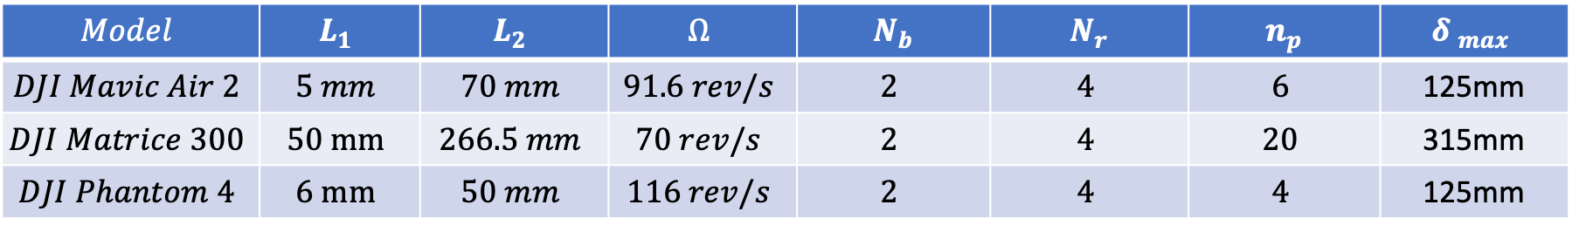
Drone model parameters
Helicopter drones:
Drone RCS are supposed to be: $σ=0.03 m^{2}$ $σ_{blade }=0.75σ$ ${ σ}_{body }=0.25σ$
$$Model$$ | $$L_{1}$$ | $$L_{2}$$ | $$Ω$$ | $${ N}_{b}$$ | $${ N}_{r}$$ | $${ n}_{p}$$
$$T−Rex 450$$ | $$42 mm$$ | $$325 mm$$ | $$40 rev/s$$ | $$2$$ | $$1$$ | $$25$$
$$T−Rex 500$$ | $$57 mm$$ | $$470 mm$$ | $$46 rev/s$$ | $$2$$ | $$1$$ | $$36$$
$$T−Rex 600$$ | $$15 mm$$ | $$600 mm$$ | $$40 rev/s$$ | $$2$$ | $$1$$ | $$46$$
Drone RCS are supposed to be: $σ=0.01 m^{2}$ $σ_{blade }=0.75σ$ ${ σ}_{body }=0.25σ$
Quadcopter drones:
$$Model$$ | $$L_{1}$$ | $$L_{2}$$ | $$Ω$$ | $${ N}_{b}$$ | $${ N}_{r}$$ | $${ n}_{p}$$ | $${δ }_{max}$$
$$DJI Mavic Air 2$$ | $$5 mm$$ | $$70 mm$$ | $$91.6 rev/s$$ | $$2$$ | $$4$$ | $$6$$ | 125mm
$$DJI Matrice 300$$ | $$50 mm$$ | $$266.5 mm$$ | $$70 rev/s$$ | $$2$$ | $$4$$ | $$20$$ | 315mm
$$DJI Phantom 4$$ | $$6 mm$$ | $$50 mm$$ | $$116 rev/s$$ | $$2$$ | $$4$$ | $$4$$ | 125mm
The blade flash start to appear when there is 1 point each 1.6 cm, are much evident for 1 point each 1.3 cm

Slide 3





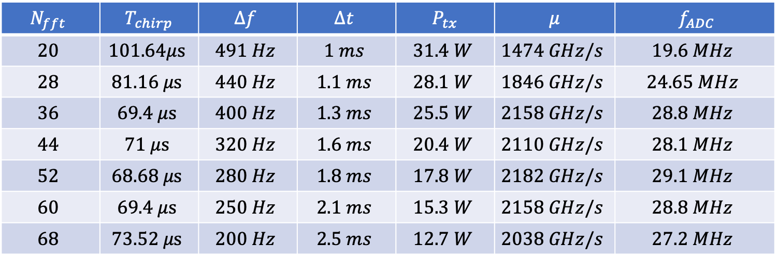



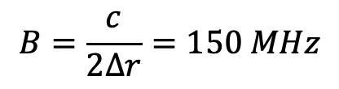









Result f-t helic. drones
Due to fmax
${ T}_{chirp_max⁡}$ = $101.9μs$
${ T}_{chirp_min⁡}$ = $66.7 μs$
Due to k range
$$f=9 GHz$$
Result for T-Rex 450 model, Objective f-t plane and maximum chirp duration:
$$λ=0.0333 m$$
$$N_{fft}$$ | $${ T}_{chirp}$$ | $$Δf$$ | $$Δt$$ | $${ P}_{tx}$$ | $$μ$$ | $${ f}_{ADC}$$
$$20$$ | $$101.64μs$$ | $$491 Hz$$ | $$1 ms$$ | $$31.4 W$$ | $$1474 GHz/s$$ | $$19.6 MHz$$
$$28$$ | $$81.16 μs$$ | $$440 Hz$$ | $$1.1 ms$$ | $$28.1 W$$ | $$1846 GHz/s$$ | $$24.65 MHz$$
$$36$$ | $$69.4 μs$$ | $$400 Hz$$ | $$1.3 ms$$ | $$25.5 W$$ | $$2158 GHz/s$$ | $$28.8 MHz$$
$$44$$ | $$71 μs$$ | $$320 Hz$$ | $$1.6 ms$$ | $$20.4 W$$ | $$2110 GHz/s$$ | $$28.1 MHz$$
$$52$$ | $$68.68 μs$$ | $$280 Hz$$ | $$1.8 ms$$ | $$17.8 W$$ | $$2182 GHz/s$$ | $$29.1 MHz$$
$$60$$ | $$69.4 μs$$ | $$250 Hz$$ | $$2.1 ms$$ | $$15.3 W$$ | $$2158 GHz/s$$ | $$28.8 MHz$$
$$68$$ | $$73.52 μs$$ | $$200 Hz$$ | $$2.5 ms$$ | $$12.7 W$$ | $$2038 GHz/s$$ | $$27.2 MHz$$
$$∆r=1 m$$
$$B=\frac{c}{2∆r}=150 MHz$$
$t_{renew}=2 s$
$${SNR}_{min}=20 dB$$
$$θ_{el}=60°$$
$$T_{s}=290 K$$
Desired time and frequency pixels:
$N_{BF}=5$
$$R_{max}=1000 m$$
$$n_{t}=5$$
${ f}_{max}$ = $4903 Hz$
${ t}_{dwell_min}$ = $0.0625 s$
$$n_{f}=5$$
${ T}_{BF}$ = $0.0125 ms$
$$θ_{az}=11.25°$$

Slide 4

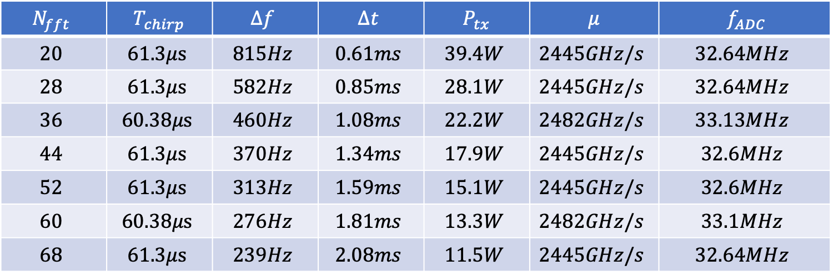








Result f-t helic. drones
Due to fmax
${ T}_{chirp_max⁡}$ = $61.3μs$
${ T}_{chirp_min⁡}$ = $60 μs$
Due to k range
Result for T-Rex 400 model, Objective f-t plane and maximum chirp duration:
$$N_{fft}$$ | $${ T}_{chirp}$$ | $$Δf$$ | $$Δt$$ | $${ P}_{tx}$$ | $$μ$$ | $${ f}_{ADC}$$
$$20$$ | $$61.3μs$$ | $$815Hz$$ | $$0.61ms$$ | $$39.4W$$ | $$2445GHz/s$$ | $$32.64MHz$$
$$28$$ | $$61.3μs$$ | $$582Hz$$ | $$0.85ms$$ | $$28.1W$$ | $$2445GHz/s$$ | $$32.64MHz$$
$$36$$ | $$60.38μs$$ | $$460Hz$$ | $$1.08ms$$ | $$22.2W$$ | $$2482GHz/s$$ | $$33.13MHz$$
$$44$$ | $$61.3μs$$ | $$370Hz$$ | $$1.34ms$$ | $$17.9W$$ | $$2445GHz/s$$ | $$32.6MHz$$
$$52$$ | $$61.3μs$$ | $$313Hz$$ | $$1.59ms$$ | $$15.1W$$ | $$2445GHz/s$$ | $$32.6MHz$$
$$60$$ | $$60.38μs$$ | $$276Hz$$ | $$1.81ms$$ | $$13.3W$$ | $$2482GHz/s$$ | $$33.1MHz$$
$$68$$ | $$61.3μs$$ | $$239Hz$$ | $$2.08ms$$ | $$11.5W$$ | $$2445GHz/s$$ | $$32.64MHz$$
Desired time and frequency pixels:
$N_{BF}=5$
${ f}_{max}$ = $8156 Hz$
$$n_{t}=5$$
We must relax k range constraint from 10 to 9
${ T}_{BF}$ = $0.0109 ms$
${ t}_{dwell_min}$ = $0.0543 s$
$$n_{f}=5$$
$$θ_{az}=9.78°$$

Slide 5

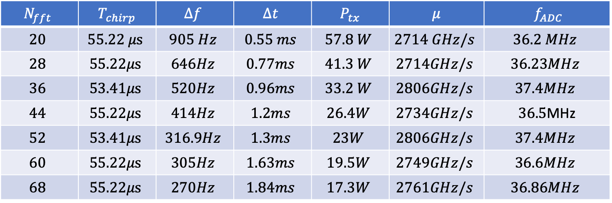







Result f-t helic. drones
Due to fmax
${ T}_{chirp_max⁡}$ = $55.22μs$
${ T}_{chirp_min⁡}$ = $53.3 μs$
Due to k range
Result for T-Rex 600 model, Objective f-t plane and maximum chirp duration:
$$N_{fft}$$ | $${ T}_{chirp}$$ | $$Δf$$ | $$Δt$$ | $${ P}_{tx}$$ | $$μ$$ | $${ f}_{ADC}$$
$$20$$ | $$55.22 μs$$ | $$905 Hz$$ | $$0.55 ms$$ | $$57.8 W$$ | $$2714 GHz/s$$ | $$36.2 MHz$$
$$28$$ | $$55.22μs$$ | $$646Hz$$ | $$0.77ms$$ | $$41.3 W$$ | $$2714GHz/s$$ | $$36.23MHz$$
$$36$$ | $$53.41μs$$ | $$520Hz$$ | $$0.96ms$$ | $$33.2 W$$ | $$2806GHz/s$$ | $$37.4MHz$$
$$44$$ | $$55.22μs$$ | $$414Hz$$ | $$1.2ms$$ | $$26.4W$$ | $$2734GHz/s$$ | $36.5$MHz
$$52$$ | $$53.41μs$$ | $$316.9Hz$$ | $$1.3ms$$ | $$23W$$ | $$2806GHz/s$$ | $$37.4MHz$$
$$60$$ | $$55.22μs$$ | $$305Hz$$ | $$1.63ms$$ | $$19.5W$$ | $$2749GHz/s$$ | $$36.6MHz$$
$$68$$ | $$55.22μs$$ | $$270Hz$$ | $$1.84ms$$ | $$17.3W$$ | $$2761GHz/s$$ | $$36.86MHz$$
Desired time and frequency pixels:
$N_{BF}=5$
${ f}_{max}$ = $9054 Hz$
$$n_{t}=5$$
We must relax k range constraint from 10 to 8
${ t}_{dwell_min}$ = $0.0625 s$
${ T}_{BF}$ = $0.0125 ms$
$$n_{f}=5$$
$$θ_{az}=11.25°$$

Slide 6
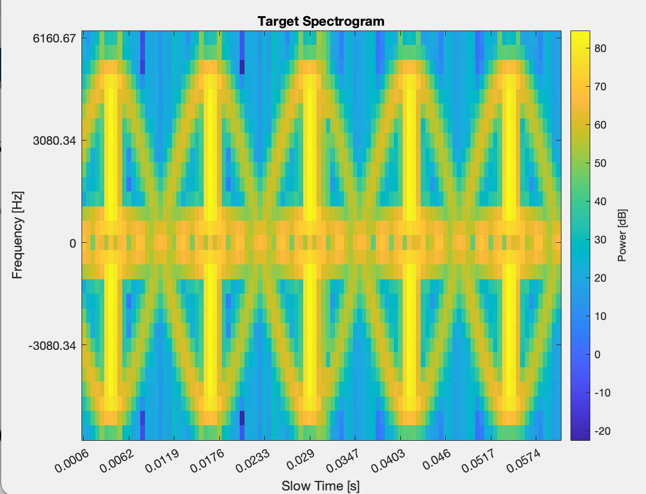
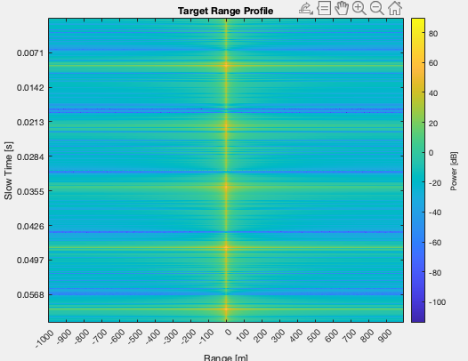
Plots f-t helic. drones
Spectrogram of first drone T-Rex 450 with N = 28
Build with 2DFFT procedure with 75% overlap
Range profile, target is supposed at 0 m distance

Slide 7
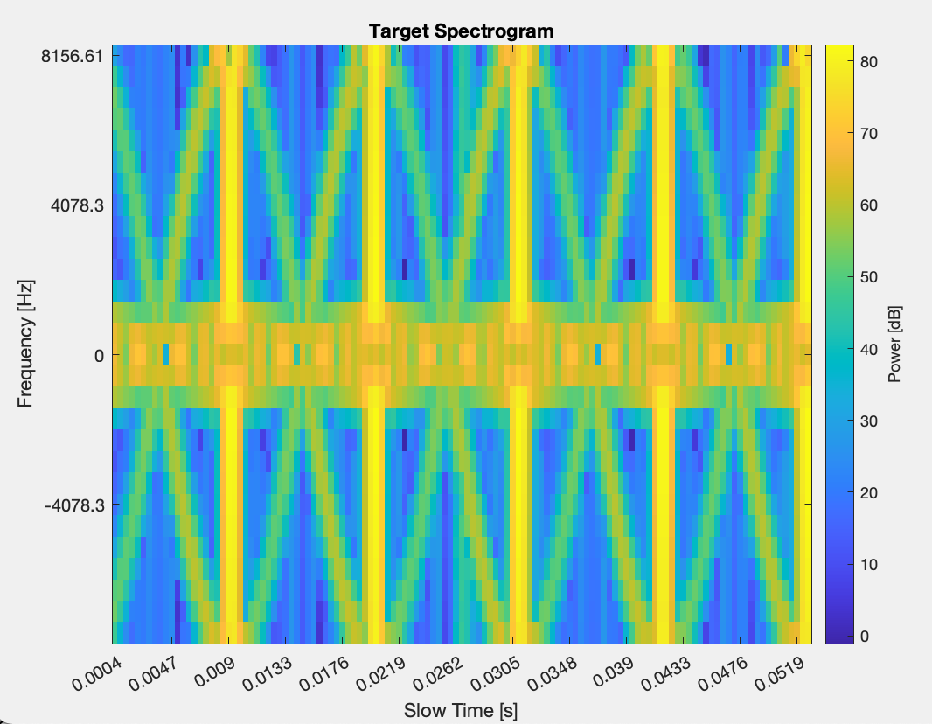
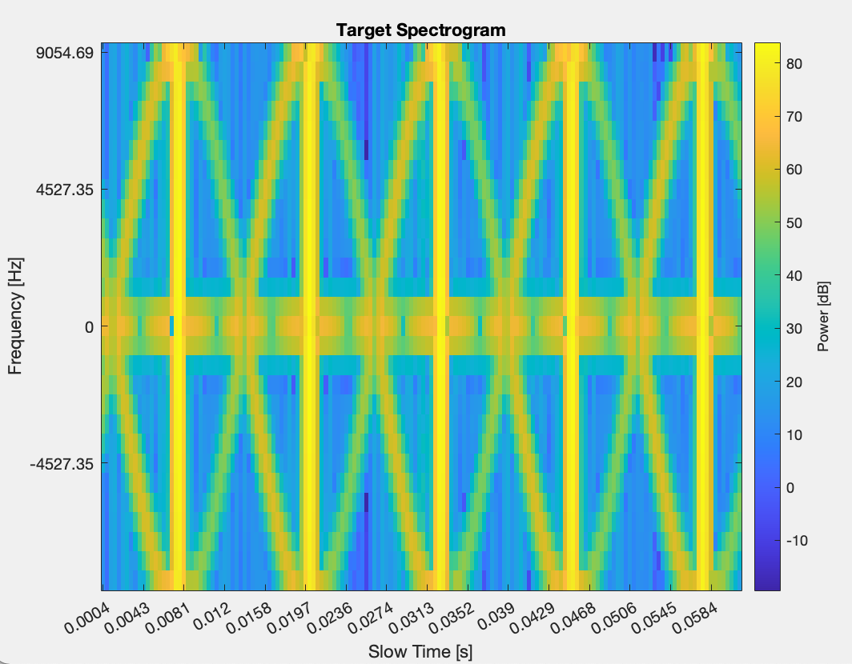
Plots f-t helic. drones
Spectrogram of second drone T-Rex 400 with N = 28
Spectrogram of second drone T-Rex 600 with N = 28
Build with 2DFFT procedure
Build with 2DFFT procedure

Slide 8
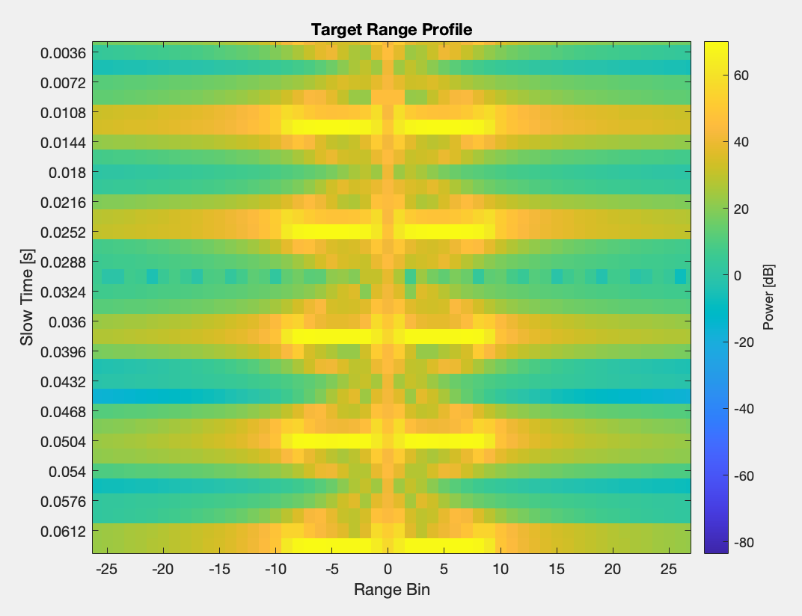















Result $ρ−t \text{helic}\text{. }\text{drones}$
Result for T-Rex 450 model, Objective $ρ−t$ plane and maximum chirp duration:
$$T_{chirp}=1.8 ms$$
$$θ_{az}=11.25°$$
$$P_{tx}=35.78 W$$
$$S=83.94 GHz/s$$
${ f}_{ADC}$ $= 1.12 MHz$
$$d=0.19 m$$
Desired time and frequency pixels:
$$N_{migr_cell}=5$$
$$N_{time_cell}=5$$
Obtained time and frequency pixels:
$$N_{migr_cell}=7$$
$N_{BF}=5$
${ f}_{max}$ = $4903 Hz$
$$N_{time_cell}=7$$
${ t}_{dwell_min}$ = $0.0625 s$
${ T}_{BF}$ = $0.125 ms$

Slide 9
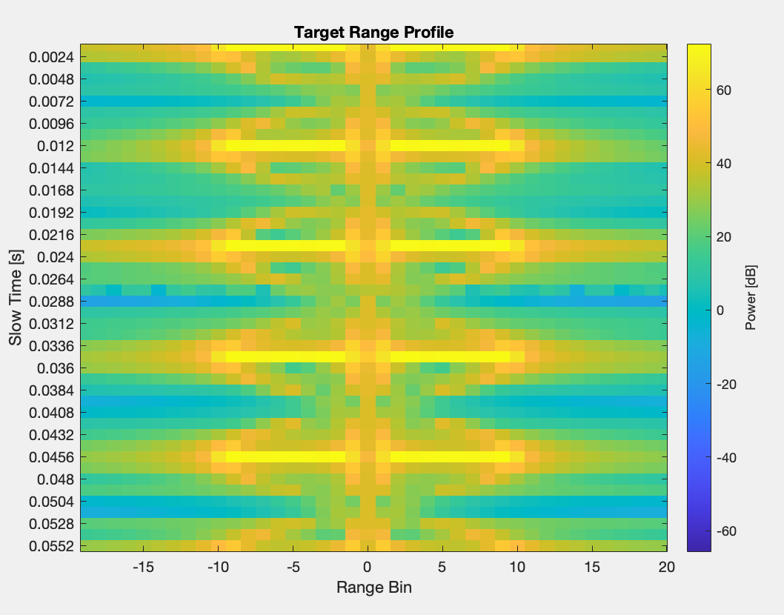















Result $ρ−t$helic. drones
Result for T-Rex 500 model, Objective $ρ−t$ plane and maximum chirp duration:
$$T_{chirp}=1.2 ms$$
$$θ_{az}=9.78°$$
$$P_{tx}=40 W$$
$$S=124 GHz/s$$
${ f}_{ADC}$ $= 1.67 MHz$
$$d=0.22m$$
Desired time and frequency pixels:
$$N_{migr_cell}=5$$
$$N_{time_cell}=5$$
Obtained time and frequency pixels:
$$N_{migr_cell}=9$$
$N_{BF}=5$
${ f}_{max}$ = $8156 Hz$
$$N_{time_cell}=9$$
${ t}_{dwell_min}$ = $0.0543s$
${ T}_{BF}$ = $0.0109 ms$

Slide 10
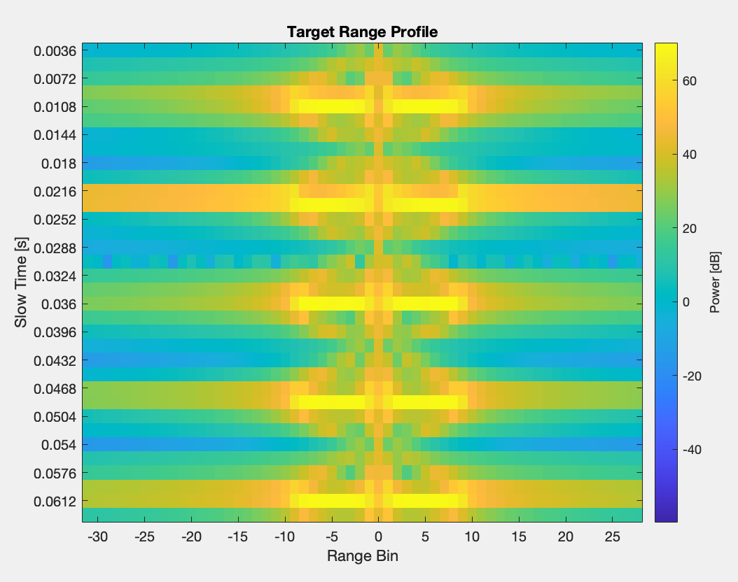















Result $ρ−t$ helic. drones
Result for T-Rex 600 model, Objective $ρ−t$ plane and maximum chirp duration:
$$T_{chirp}=1.3 ms$$
$$θ_{az}=11.25°$$
$$P_{tx}=51.12W$$
$$S=119 GHz/s$$
${ f}_{ADC}$ $= 1.61 MHz$
$$d=0.19m$$
Desired time and frequency pixels:
$$N_{migr_cell}=5$$
$$N_{time_cell}=5$$
Obtained time and frequency pixels:
$$N_{migr_cell}=10$$
$$N_{time_cell}=10$$
$N_{BF}=5$
${ f}_{max}$ = $9054 Hz$
${ t}_{dwell_min}$ = $0.0625 s$
${ T}_{BF}$ = $0.0125 ms$

Slide 11


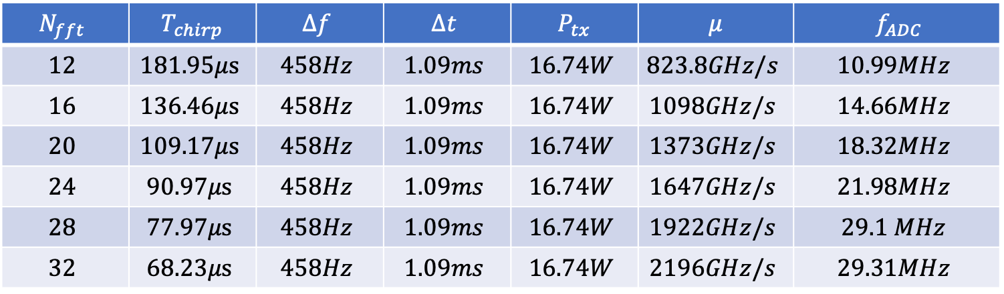



Result f-t quad. drones
Due to fmax
${ T}_{chirp_max⁡}$ = $206.7μs$
${ T}_{chirp_min⁡}$ = $66.7 μs$
Due to k range
$$f=9 GHz$$
Result for DJI Maciv air 2 model, Objective f-t plane and maximum chirp duration:
$$λ=0.0333 m$$
$$N_{fft}$$ | $${ T}_{chirp}$$ | $$Δf$$ | $$Δt$$ | $${ P}_{tx}$$ | $$μ$$ | $${ f}_{ADC}$$
$$12$$ | $$181.95μs$$ | $$458Hz$$ | $$1.09ms$$ | $$16.74W$$ | $$823.8GHz/s$$ | $$10.99MHz$$
$$16$$ | $$136.46μs$$ | $$458Hz$$ | $$1.09ms$$ | $$16.74W$$ | $$1098GHz/s$$ | $$14.66MHz$$
$$20$$ | $$109.17μs$$ | $$458Hz$$ | $$1.09ms$$ | $$16.74W$$ | $$1373GHz/s$$ | $$18.32MHz$$
$$24$$ | $$90.97μs$$ | $$458Hz$$ | $$1.09ms$$ | $$16.74W$$ | $$1647GHz/s$$ | $$21.98MHz$$
$$28$$ | $$77.97μs$$ | $$458Hz$$ | $$1.09ms$$ | $$16.74W$$ | $$1922GHz/s$$ | $$29.1 MHz$$
$$32$$ | $$68.23μs$$ | $$458Hz$$ | $$1.09ms$$ | $$16.74W$$ | $$2196GHz/s$$ | $$29.31MHz$$
$$∆r=1 m$$
$$B=\frac{c}{2∆r}=150 MHz$$
$t_{renew}=2 s$
$${SNR}_{min}=20 dB$$
$$θ_{el}=60°$$
$$T_{s}=290 K$$
d = 0.44m
Desired time and frequency pixels:
$N_{BF}=5$
$$R_{max}=1000 m$$
$$n_{t}=5$$
${ f}_{max}$ = $2418 Hz$
${ t}_{dwell_min}$ = $0.0273 s$
$$n_{f}=5$$
${ T}_{BF}$ = $0.0055 ms$
$$θ_{az}=4.9°$$

Slide 12

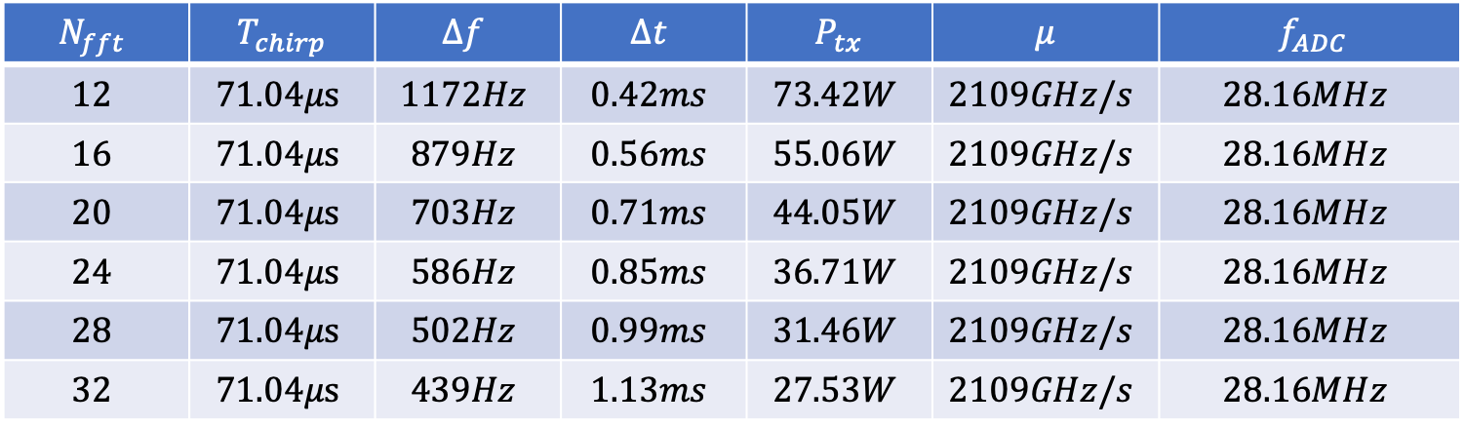







Result f-t quad. drones
Due to fmax
${ T}_{chirp_max⁡}$ = $71.04μs$
${ T}_{chirp_min⁡}$ = $66.7 μs$
Due to k range
Result for $DJI Matrice 300$ model, Objective f-t plane and maximum chirp duration:
$$N_{fft}$$ | $${ T}_{chirp}$$ | $$Δf$$ | $$Δt$$ | $${ P}_{tx}$$ | $$μ$$ | $${ f}_{ADC}$$
$$12$$ | $$71.04μs$$ | $$1172Hz$$ | $$0.42ms$$ | $$73.42W$$ | $$2109GHz/s$$ | $$28.16MHz$$
$$16$$ | $$71.04μs$$ | $$879Hz$$ | $$0.56ms$$ | $$55.06W$$ | $$2109GHz/s$$ | $$28.16MHz$$
$$20$$ | $$71.04μs$$ | $$703Hz$$ | $$0.71ms$$ | $$44.05W$$ | $$2109GHz/s$$ | $$28.16MHz$$
$$24$$ | $$71.04μs$$ | $$586Hz$$ | $$0.85ms$$ | $$36.71W$$ | $$2109GHz/s$$ | $$28.16MHz$$
$$28$$ | $$71.04μs$$ | $$502Hz$$ | $$0.99ms$$ | $$31.46W$$ | $$2109GHz/s$$ | $$28.16MHz$$
$$32$$ | $$71.04μs$$ | $$439Hz$$ | $$1.13ms$$ | $$27.53W$$ | $$2109GHz/s$$ | $$28.16MHz$$
Desired time and frequency pixels:
$N_{BF}=5$
$$n_{t}=5$$
${ f}_{max}$ = $7037 Hz$
${ t}_{dwell_min}$ = $0.0357 s$
$$n_{f}=5$$
${ T}_{BF}$ = $0.0071 ms$
$$θ_{az}=6.42°$$

Slide 13

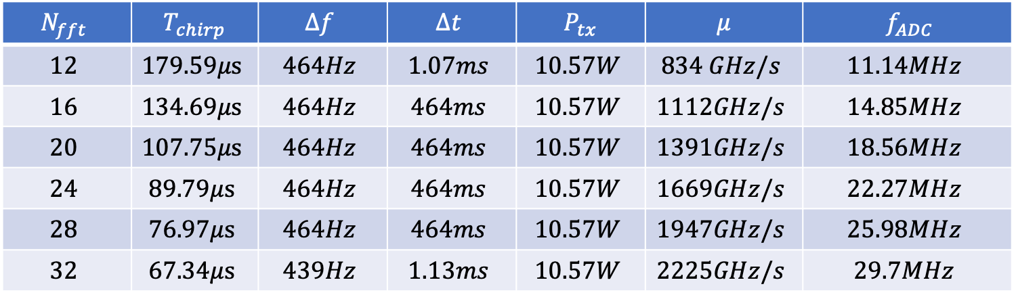






Result f-t quad. drones
Due to fmax
${ T}_{chirp_max⁡}$ = $228μs$
${ T}_{chirp_min⁡}$ = $66.7 μs$
Due to k range
Result for $DJI Panthom 4$ model, Objective f-t plane and maximum chirp duration:
$$N_{fft}$$ | $${ T}_{chirp}$$ | $$Δf$$ | $$Δt$$ | $${ P}_{tx}$$ | $$μ$$ | $${ f}_{ADC}$$
$$12$$ | $$179.59μs$$ | $$464Hz$$ | $$1.07ms$$ | $$10.57W$$ | $$834 GHz/s$$ | $$11.14MHz$$
$$16$$ | $$134.69μs$$ | $$464Hz$$ | $$464ms$$ | $$10.57W$$ | $$1112GHz/s$$ | $$14.85MHz$$
$$20$$ | $$107.75μs$$ | $$464Hz$$ | $$464ms$$ | $$10.57W$$ | $$1391GHz/s$$ | $$18.56MHz$$
$$24$$ | $$89.79μs$$ | $$464Hz$$ | $$464ms$$ | $$10.57W$$ | $$1669GHz/s$$ | $$22.27MHz$$
$$28$$ | $$76.97μs$$ | $$464Hz$$ | $$464ms$$ | $$10.57W$$ | $$1947GHz/s$$ | $$25.98MHz$$
$$32$$ | $$67.34μs$$ | $$439Hz$$ | $$1.13ms$$ | $$10.57W$$ | $$2225GHz/s$$ | $$29.7MHz$$
Desired time and frequency pixels:
$N_{BF}=5$
$$n_{t}=4$$
${ f}_{max}$ = $2188 Hz$
${ t}_{dwell_min}$ = $0.0216 s$
$$n_{f}=4$$
${ T}_{BF}$ = $0.0043 ms$
$$θ_{az}=3.87°$$
Must relax from 5 to 4

Slide 14
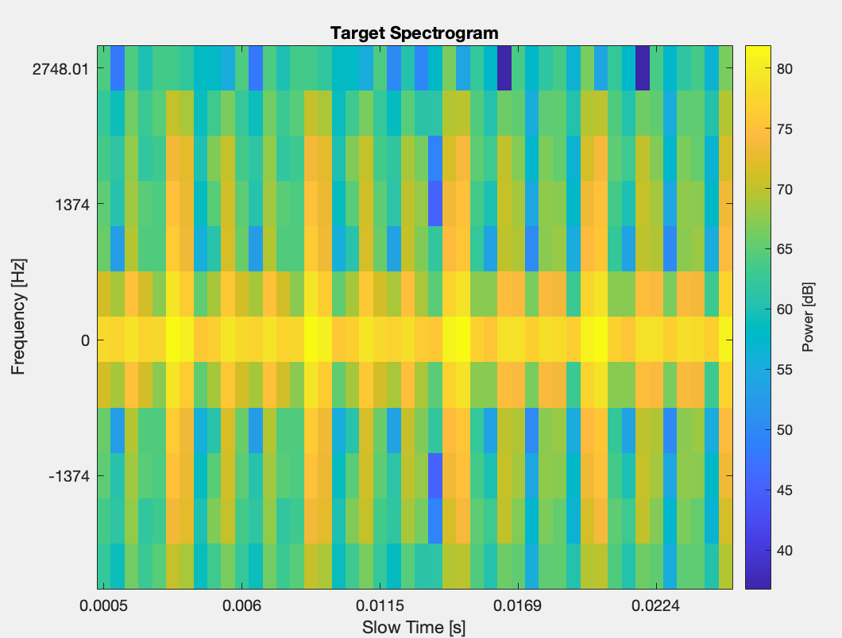
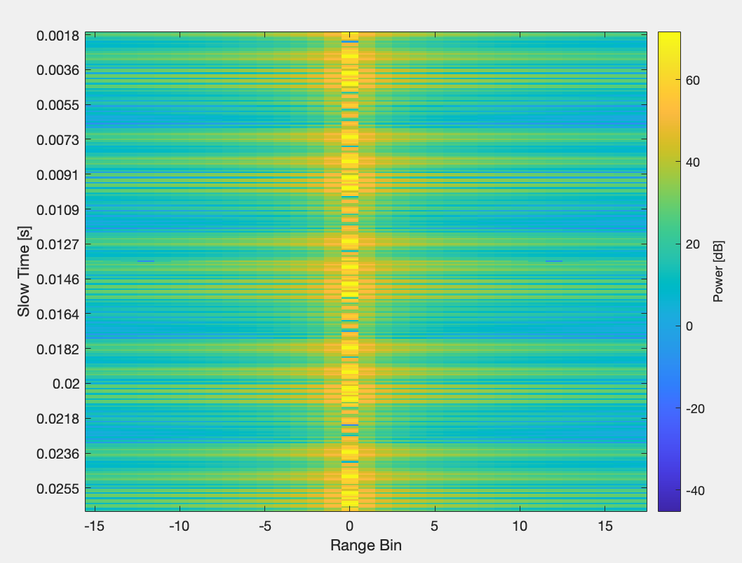

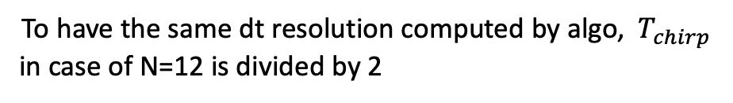
Plots f-t helic. drones
Spectrogram of DJI Mavic air 2 with N = 12
Range profile without migration
Build with 2DFFT procedure with 75% overlap
With respect to the spectrogram build with STFT
In this case the dt is 2 times
To have the same dt resolution computed by algo, ${ T}_{chirp}$
in case of N=12 is divided by 2
${ T}_{chirp}$ = $90μs$

Slide 15
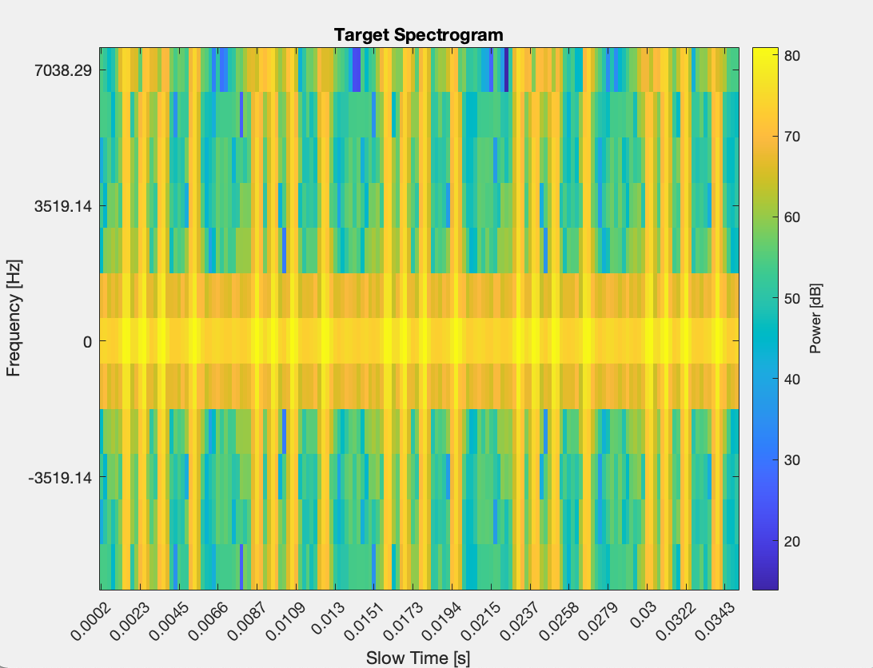
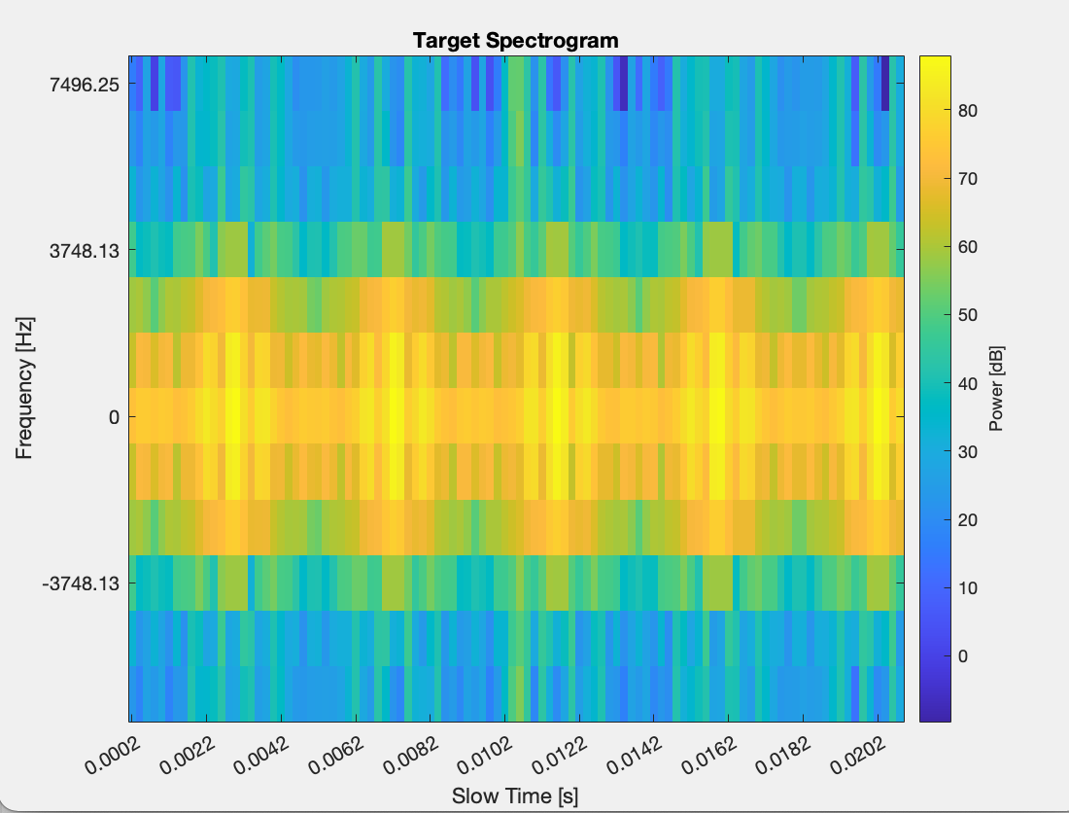


Plots f-t helic. drones
Spectrogram of second drone $DJI Phantom 4$
with N = 12
Spectrogram of drone $DJI Matrice 300$ with N = 12
${ T}_{chirp}$ = $66.7μs$
Build with 2DFFT procedure with 75% overlap
Build with 2DFFT procedure with 75% overlap

Slide 16
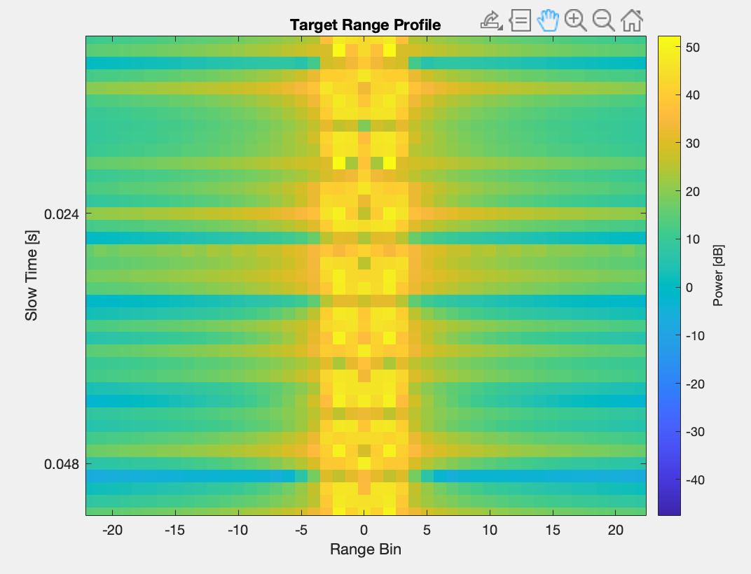















Result $ρ−t \text{quad}\text{. }\text{drones}$
Result for $DJI Mavic Air 2$model, Objective $ρ−t$ plane and maximum chirp duration:
$$T_{chirp}=1.2 ms$$
$$θ_{az}=6.87°$$
$$P_{tx}=4 W$$
$$S=604 GHz/s$$
${ f}_{ADC}$ $=8.07 MHz$
$$d=0.31m$$
Desired time and frequency pixels:
$$N_{migr_cell}=1$$
$$N_{time_cell}=1$$
Obtained time and frequency pixels:
$$N_{migr_cell}=3$$
$N_{peak}=7$
${ f}_{max}$ = $2418 Hz$
$$N_{time_cell}=3$$
${ t}_{dwell_min}$ = $0.0382 s$
${ T}_{BF}$ = $0.0055 ms$

Slide 17
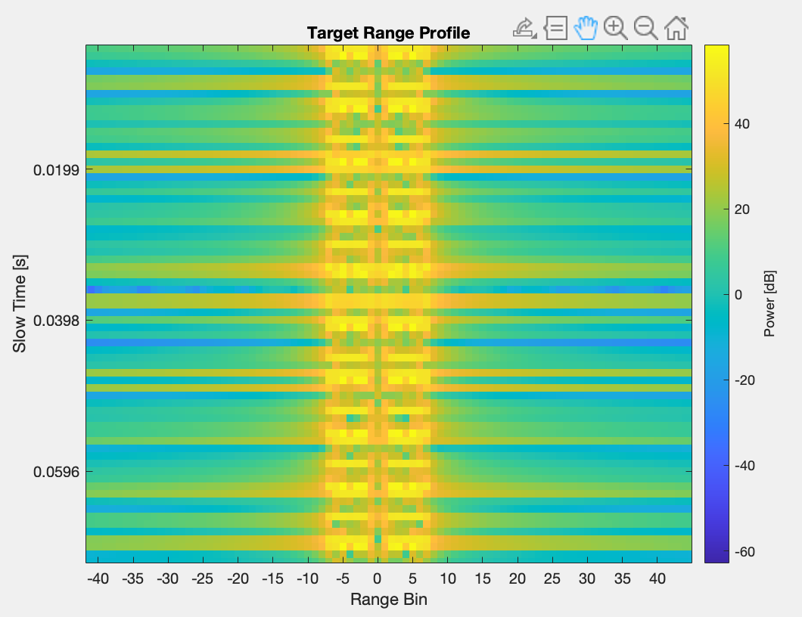














Result $ρ−t$helic. drones
Result for DJI Matrice 300 model, Objective $ρ−t$ plane and maximum chirp duration:
$$T_{chirp}=0.994 ms$$
$$θ_{az}=9°$$
$$P_{tx}=8.56W$$
$$S=753 GHz/s$$
${ f}_{ADC}$ $= 10.06 MHz$
$$d=0.24m$$
Desired time and frequency pixels:
$$N_{migr_cell}=5$$
$$N_{time_cell}=5$$
Obtained time and frequency pixels:
$$N_{migr_cell}=7$$
$N_{BF}=7$
${ f}_{max}$ = $7037 Hz$
$$N_{time_cell}=7$$
${ t}_{dwell_min}$ = $0.05 s$
${ T}_{BF}$ = $0.0071 ms$

Slide 18
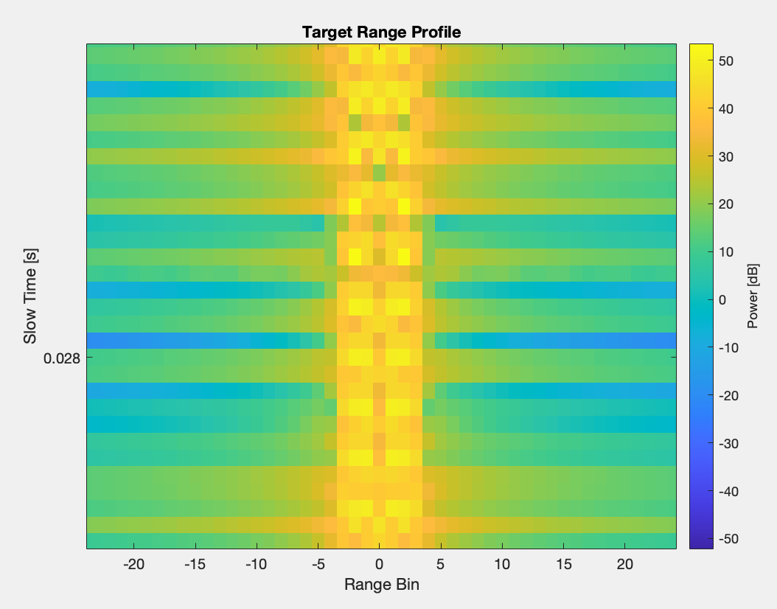














Result $ρ−t$ helic. drones
Result for DJI Panthom 4 model, Objective $ρ−t$ plane and maximum chirp duration:
$$T_{chirp}=1.4 ms$$
$$θ_{az}=6.20°$$
$$P_{tx}=20.44W$$
$$S=119 GHz/s$$
${ f}_{ADC}$ $= 1.61 MHz$
$$d=0.09m$$
Starting time and frequency pixels:
$$N_{migr_cell}=1$$
$$N_{time_cell}=1$$
Obtained time and frequency pixels:
$$N_{migr_cell}=3$$
$N_{BF}=8$
${ f}_{max}$ = $2188 Hz$
$$N_{time_cell}=3$$
${ t}_{dwell_min}$ = $0.0345 s$
${ T}_{BF}$ = $0.0043 ms$

Slide 19
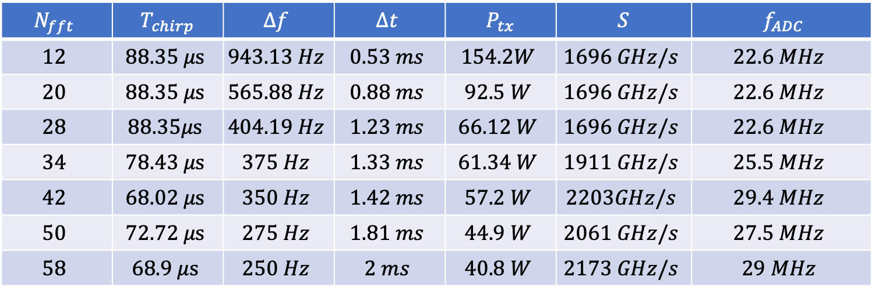
Result f-t helic. drones
Due to fmax
${ T}_{chirp_max⁡}$ = $101.9μs$
${ T}_{chirp_min⁡}$ = $66.7 μs$
Due to k range
$$f=9 GHz$$
Result for generic helic drone model, Objective f-t plane and maximum chirp duration:
$$λ=0.0333 m$$
$$N_{fft}$$ | $${ T}_{chirp}$$ | $$Δf$$ | $$Δt$$ | $${ P}_{tx}$$ | $$S$$ | $${ f}_{ADC}$$
$$12$$ | $$88.35 μs$$ | $$943.13 Hz$$ | $$0.53 ms$$ | $$154.2W$$ | $$1696 GHz/s$$ | $$22.6 MHz$$
$$20$$ | $$88.35 μs$$ | $$565.88 Hz$$ | $$0.88 ms$$ | $$92.5 W$$ | $$1696 GHz/s$$ | $$22.6 MHz$$
$$28$$ | $$88.35μs$$ | $$404.19 Hz$$ | $$1.23 ms$$ | $$66.12 W$$ | $$1696 GHz/s$$ | $$22.6 MHz$$
$$34$$ | $$78.43 μs$$ | $$375 Hz$$ | $$1.33 ms$$ | $$61.34 W$$ | $$1911 GHz/s$$ | $$25.5 MHz$$
$$42$$ | $$68.02 μs$$ | $$350 Hz$$ | $$1.42 ms$$ | $$57.2 W$$ | $$2203GHz/s$$ | $$29.4 MHz$$
$$50$$ | $$72.72 μs$$ | $$275 Hz$$ | $$1.81 ms$$ | $$44.9 W$$ | $$2061 GHz/s$$ | $$27.5 MHz$$
$$58$$ | $$68.9 μs$$ | $$250 Hz$$ | $$2 ms$$ | $$40.8 W$$ | $$2173 GHz/s$$ | $$29 MHz$$
$$∆r=1 m$$
$$B=\frac{c}{2∆r}=150 MHz$$
$t_{renew}=2 s$
$${SNR}_{min}=20 dB$$
$$θ_{el}=60°$$
$$T_{s}=290 K$$
Desired time and frequency pixels:
$N_{BF}=5$
$$R_{max}=1000 m$$
$$n_{t}=5$$
${ f}_{max}$ = $4903 Hz$
${ t}_{dwell_min}$ = $0.0625 s$
$$n_{f}=5$$
${ T}_{BF}$ = $0.0125 ms$
$$θ_{az}=11.25°$$

Slide 20


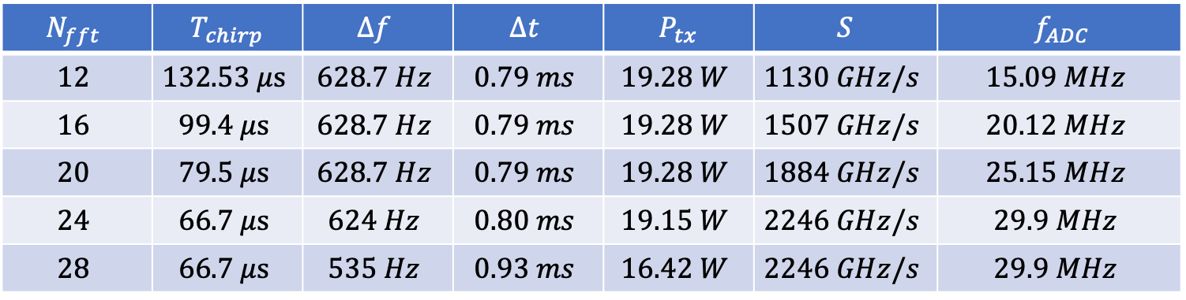



Result f-t quad. drones
Due to fmax
${ T}_{chirp_max⁡}$ = $132.53 μs$
${ T}_{chirp_min⁡}$ = $66.7 μs$
Due to k range
$$f=9 GHz$$
Result for generic quad drone model, Objective f-t plane and maximum chirp duration:
$$λ=0.0333 m$$
$$N_{fft}$$ | $${ T}_{chirp}$$ | $$Δf$$ | $$Δt$$ | $${ P}_{tx}$$ | $$S$$ | $${ f}_{ADC}$$
$$12$$ | $$132.53 μs$$ | $$628.7 Hz$$ | $$0.79 ms$$ | $$19.28 W$$ | $$1130 GHz/s$$ | $$15.09 MHz$$
$$16$$ | $$99.4 μs$$ | $$628.7 Hz$$ | $$0.79 ms$$ | $$19.28 W$$ | $$1507 GHz/s$$ | $$20.12 MHz$$
$$20$$ | $$79.5 μs$$ | $$628.7 Hz$$ | $$0.79 ms$$ | $$19.28 W$$ | $$1884 GHz/s$$ | $$25.15 MHz$$
$$24$$ | $$66.7 μs$$ | $$624 Hz$$ | $$0.80 ms$$ | $$19.15 W$$ | $$2246 GHz/s$$ | $$29.9 MHz$$
$$28$$ | $$66.7 μs$$ | $$535 Hz$$ | $$0.93 ms$$ | $$16.42 W$$ | $$2246 GHz/s$$ | $$29.9 MHz$$
$$∆r=1 m$$
$$B=\frac{c}{2∆r}=150 MHz$$
$t_{renew}=2 s$
$${SNR}_{min}=20 dB$$
$$θ_{el}=60°$$
$$T_{s}=290 K$$
Desired time and frequency pixels:
$N_{BF}=5$
$$R_{max}=1000 m$$
$$n_{t}=5$$
${ f}_{max}$ =3.772$Hz$
${ t}_{dwell_min}$ = $0.0250 s$
$$n_{f}=5$$
${ T}_{BF}$ = $0.0125 ms$
$$θ_{az}=4.5°$$

